Slide 1
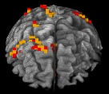
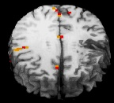
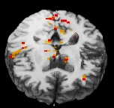

Neuro-Imaging Core Director: Dr. Crosson
Word Production
Activity in Aphasia
Mission: To provide CVNR investigators with the tools, expertise, and training necessary to measure brain structures and plasticity of brain systems using structural and functional and neuroimaging.
Resources:
30 TB data server + 4 virtual workstations
42 TB backup server
5 Linux/Mac workstations
.5 FTE data processing and training

Slide 2
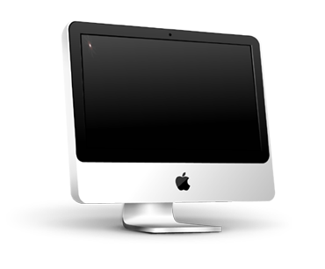
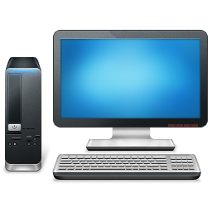



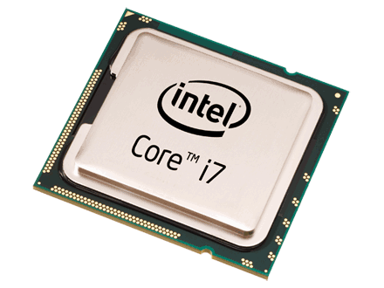
Emory
Network overview – WMB
LDAP
imacs:
16GB RAM
OSX
4 cores
nVidia Graphics
Workstations:
.birc.emory.edu
Lens
Larry
Ralph
Pano
rama
Workstations:
48GB RAM
Xubuntu 14.04
12 cores – 24threads
nVidia Graphics

Slide 3
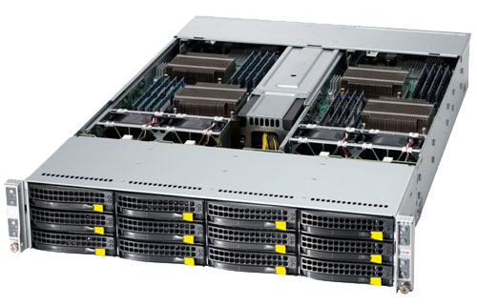
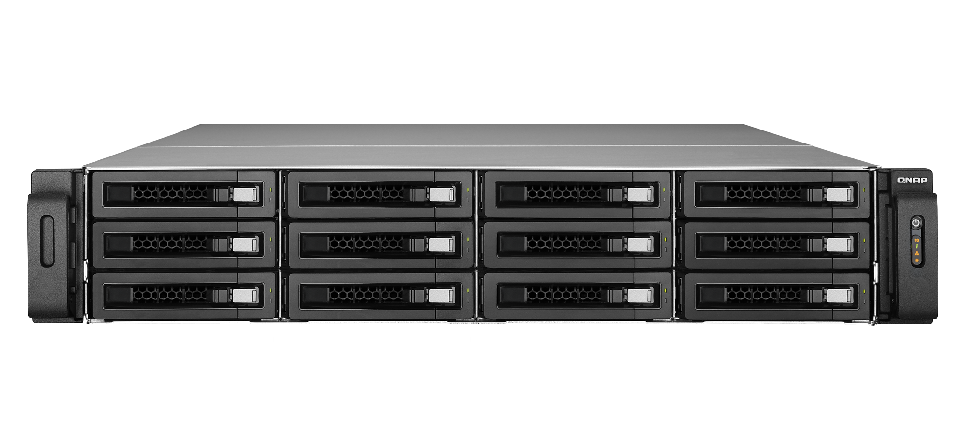
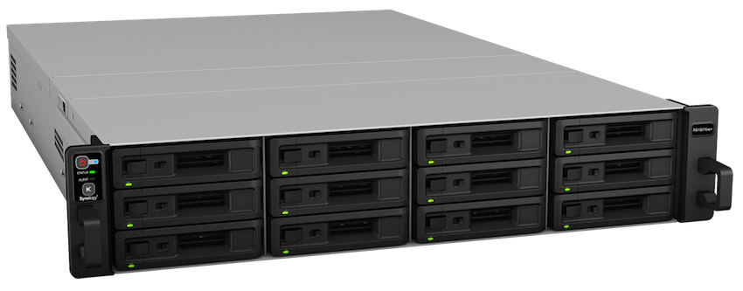
Servers & qballs
40 TB data server
30 TB data server
1599 -hippoback
NDB - hippostore
Qballs - LDAP
52 TB data server – 4Gbps
Qballs: 24GB RAM Xubuntu 14.04 8 cores – 16threads slow

Slide 4




Giri User Experience - VA
image
SSH
NFS
Qballs LDAP
x2go
NFS
NFS Servers
x2go
NFS
NFS
Ralph
Lens
Larry
SSH
LDAP
Pano
Rama

